Slide 1
Information Architecture
& Navigation

Slide 2
Summary
Standards
Why?
Information Architecture
Visual language
Formatting
Navigation
Where are you now?
How did you get here?
Where are you going?
Notes:
Guidelines on

Slide 3
Why have them?
Standards
Notes:
We begin with a quick talk about standards & best practices. Why are they important? They’re not here to crush your creativity.
Rather, while using the net, people form habits and will come to your site, expecting a certain number of standard cues

Slide 4
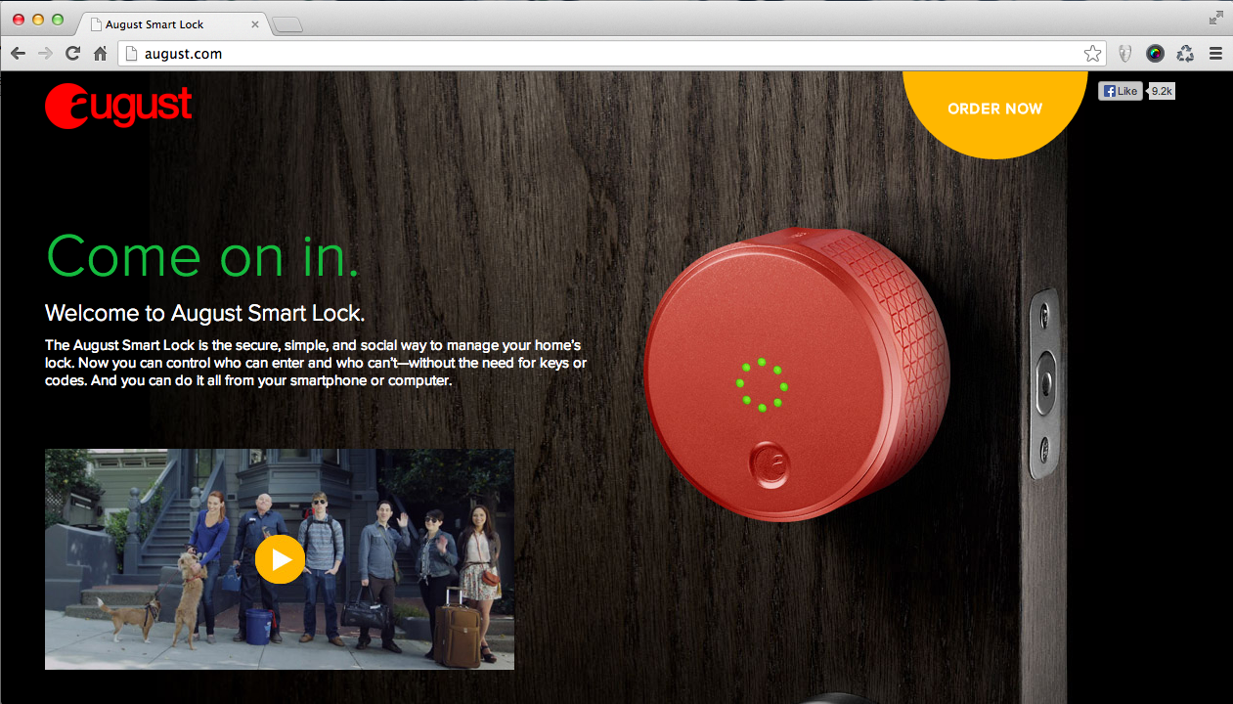
Notes:
Beautiful, but what are you going to do next? Click on the button? Ah- but its not a button. How many sections in this site? Don’t know?

Slide 5
Standards help users
Users scan, rely on common knowledge
Help find content
Use your site
Notes:
So by learning the following standards, you can help your users intuitively navigate and use your site.
Did you know? Most people don’t read everything – they scan your page. They rely on their intuition, common knowledge and *standards* to guide their behavior. So lets learn some…

Slide 6
Information Architecture
Notes:
Information architecture is the structuring of content to help ensure hierarchy and understanding

Slide 7
Visual language
Information Architecture

Slide 8
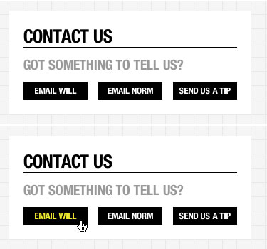
:hover states
Tested.com
Notes:
An easy way to indicate active, clickable items is to use hover states. When you roll over something with a cursor, it will visually change.

Slide 9
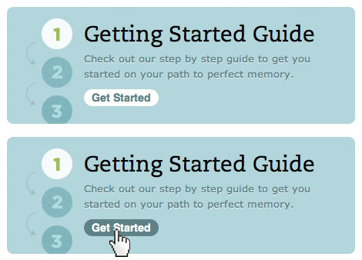
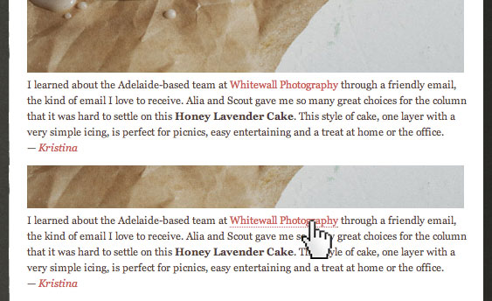
evernote
designsponge

Slide 10

a {
text-decoration: none;
}
a:hover {
text-decoration: underline;
}

Slide 11

Icons
How recognizable?
Labels or alt text
No mystery-meat navigation
squarespace

Slide 12


gmail
squarespace

Slide 13
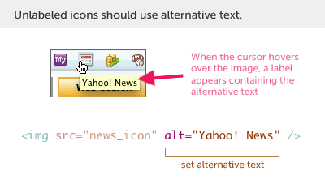
Add alt text to an image

Slide 14
Formatting content
Information Architecture

Slide 15
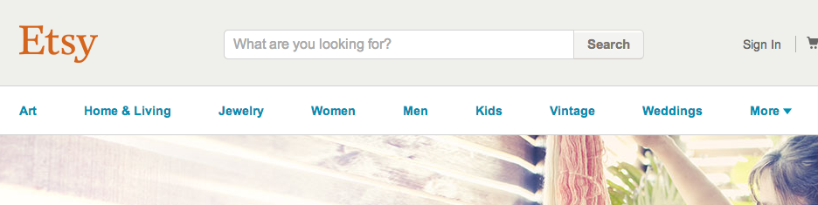
Lists and menus
Categories based on content
Manageable # of items
Clear grouping
Notes:
Lists and menus should be clear, easy to find. Usually along the top or side of a site

Slide 16
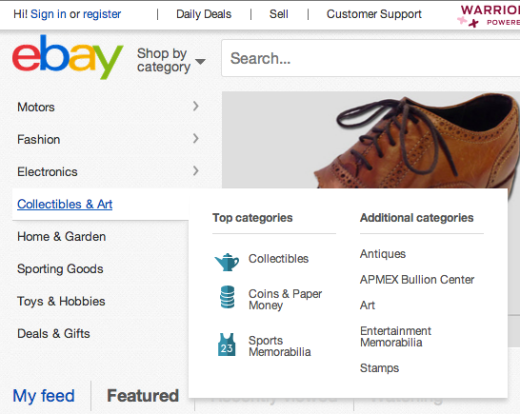
Notes:
Notice how ebay has different groups than etsty? They cater to their users’ preferences. Etsy: art is no1, Ebay: motors is no1.

Slide 17
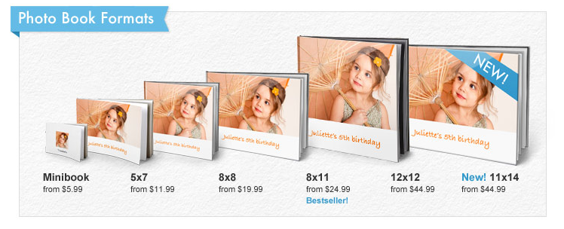
Comparisons
Focus on key differences
Reduce visual noise
Continuation: Lines can be implied
Snapfish
Notes:
If you have a lot of content to compare, help the user by letting them focus on the key differences and reducing distractions.
- You can reduce visual noise by keeping many of the elements consistent. Line your content up, and use the same colors and placement of labels. That way, differences between items are easier to spot. Also, notice how you don’t need to physically draw a line – Based on the gestalt principle of continuation: A users’ eye will naturally be compelled to “move through one object and continue to another”

Slide 18
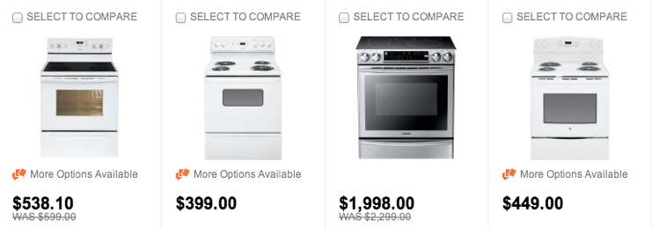
Home depot
Notes:
Imagine a page of 25 ovens, how to decide on one? Skim! Lots of similar things, but you can easily compare similar things like price.

Slide 19
Navigation

Slide 20
Give directions to users
Where are you now?
How did you get here?
Where are you going now?
Notes:
Navigation in a website is important since it lets your users figure out how to get from place to place. There are 3 main topics.

Slide 21
Where are you now?
Navigation

Slide 22

Site Logo & page title
Logos top left or top center
Window size
Name of page/section
Notes:
Logos and page titles again are a standard. People are trained to look for them in that spot.

Slide 23
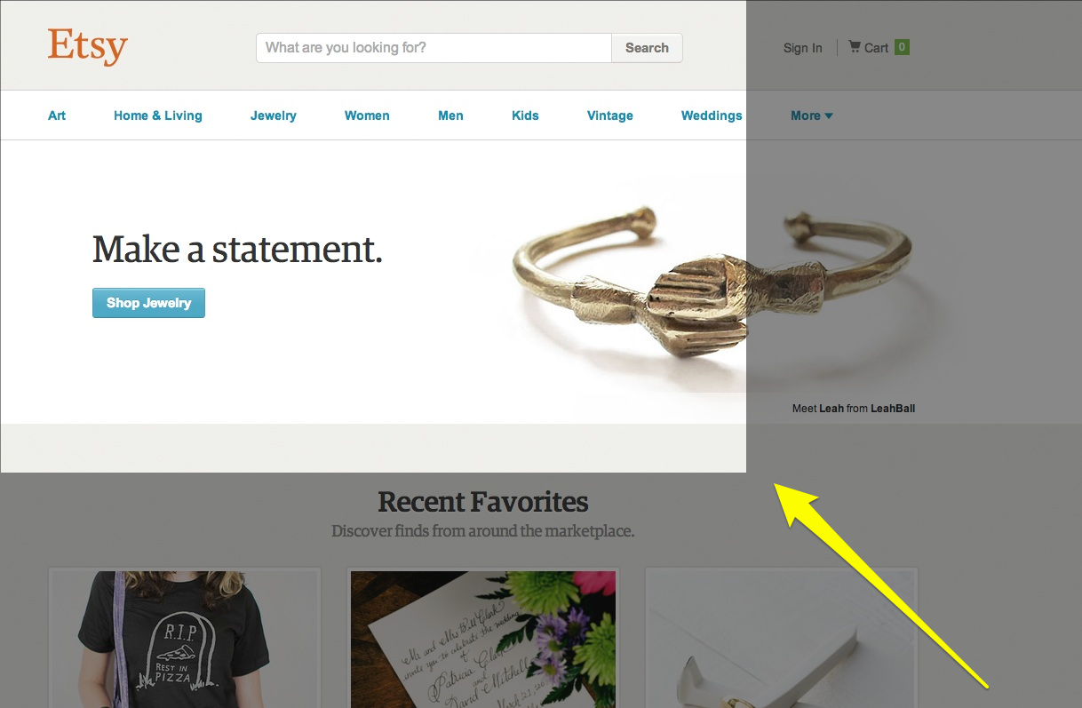
Notes:
Diff window sizes to account for.

Slide 24
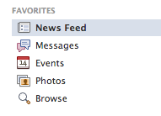
Indicate current state
Font weight, color
Background
Icon
Size
Notes:
Show the current page or what is selected. There’s lots of ways to show your current state as long as it stands out again the other possible states.

Slide 25




hulu
etsy
uber
ars technica
Notes:
Here’s some common examples of a slideshow and pagination (showing a list of page)

Slide 26
How did you get here?
Navigation

Slide 27
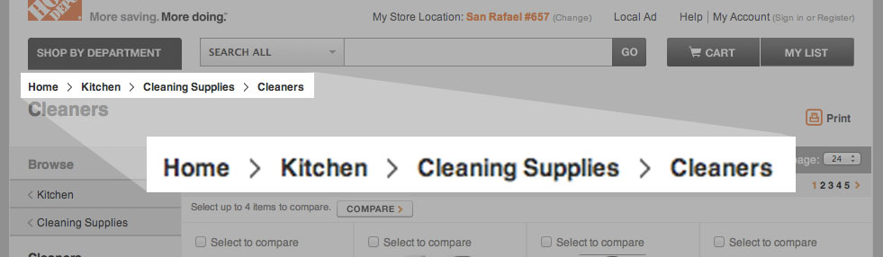
Breadcrumbs
Trail/path you took, category hierarchy
General > specific
Top left, page title underneath
Home Depot

Slide 28


History indicators
Mailchimp
Etsy
Notes:
Where you’ve been or what you’ve selected

Slide 29
Where are you going?
Navigation
Notes:
Think about what you’re going to do next. Very important in purchasing or anything interactive. You don’t want people to stay on one page forever.

Slide 30
Link text
Action: read more, add to cart, [go] back to top
Content to be revealed: previous page, account, portfolio

Slide 31
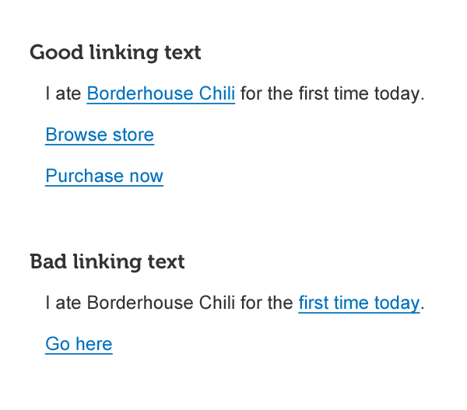

Slide 32
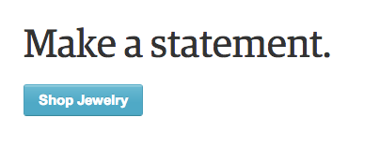
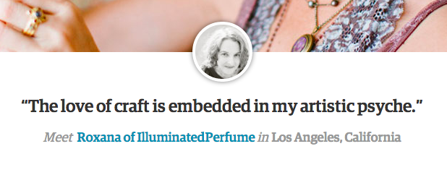
etsy

Slide 33
Review
Standards
Why? – Common knowledge
Information Architecture
Visual language – Hover states, icons
Formatting – lists & menus
Navigation
Now – Logo & title, current states
Past – breadcrumbs, history
Future - Link text
Notes:
So, to wrap up, we learned lots of different best practices all in the name of helping your users to quickly use your site. Let them concentrate on your content and not be distracted or frustrated trying to learn.

